Slide 1
Projects

Slide 2


Slide 3


Slide 4


Slide 5


Slide 6


Slide 7
Can I predict who WON’T get drafted?

Slide 8
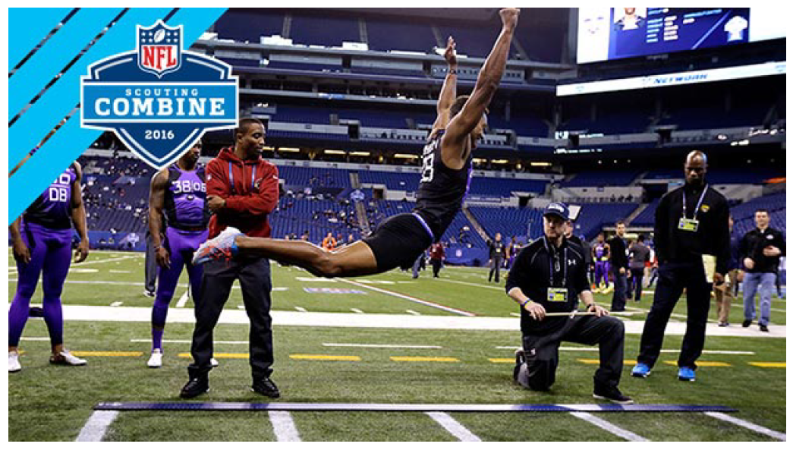

Slide 9
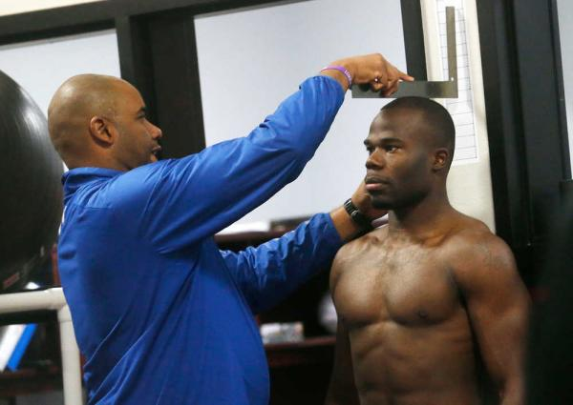

Slide 10


Slide 11


Slide 12
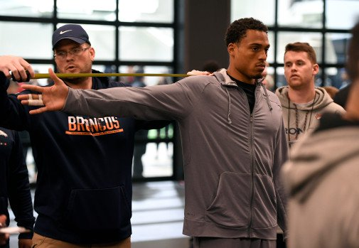

Slide 13
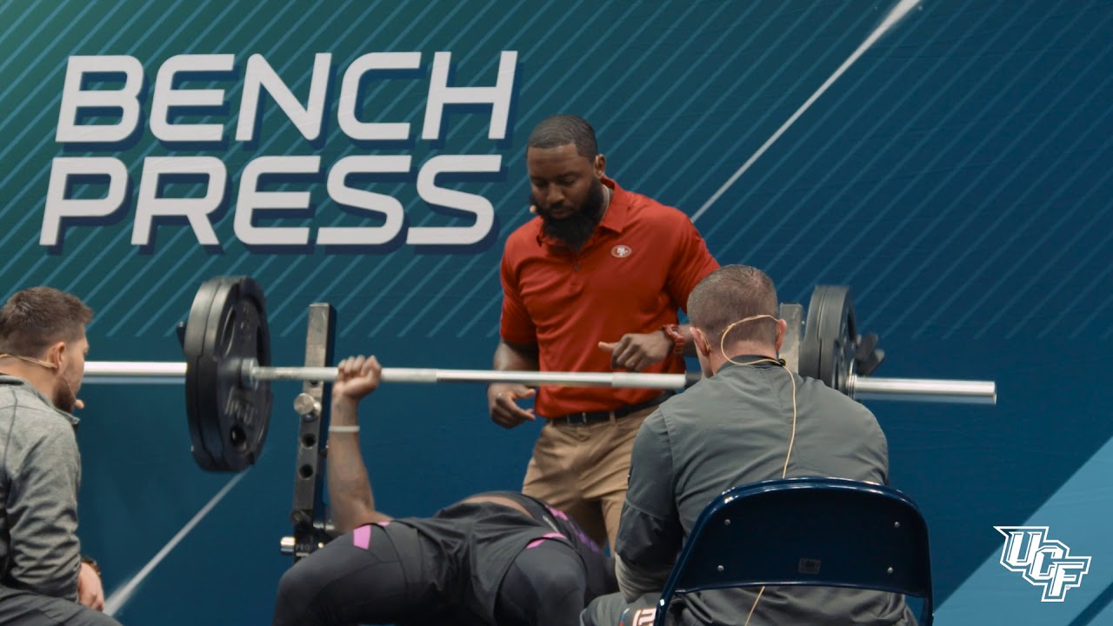

Slide 14
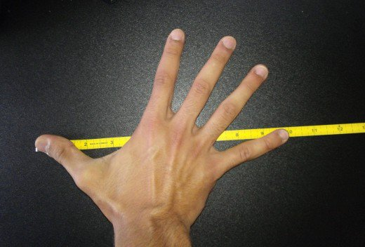

Slide 15


Slide 16
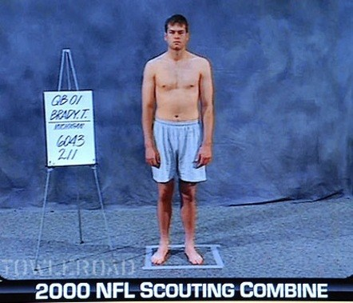

Slide 17
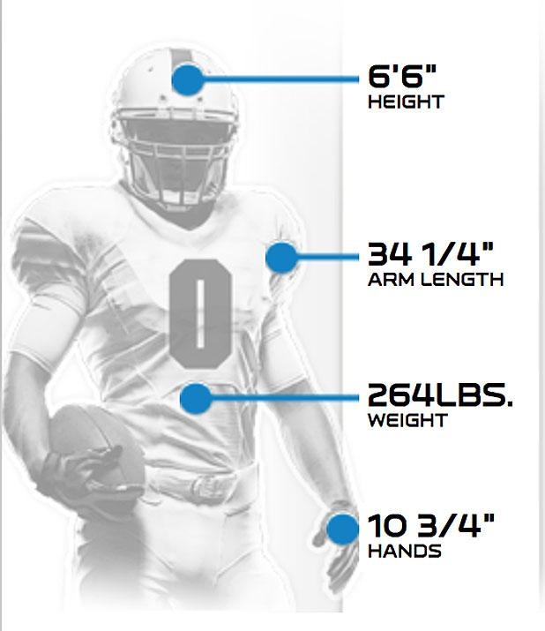

Slide 18
Wonderlic
NFL IQ Test

Slide 19
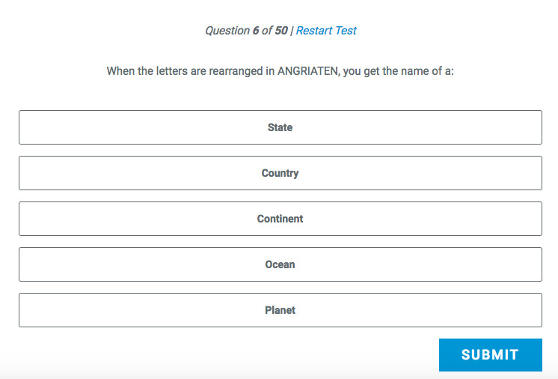

Slide 20
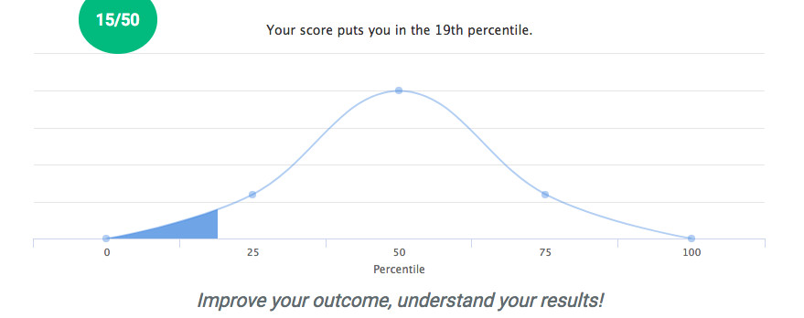

Slide 21
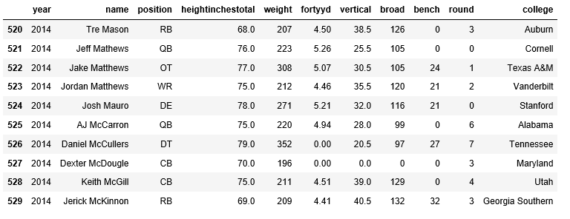

Slide 22
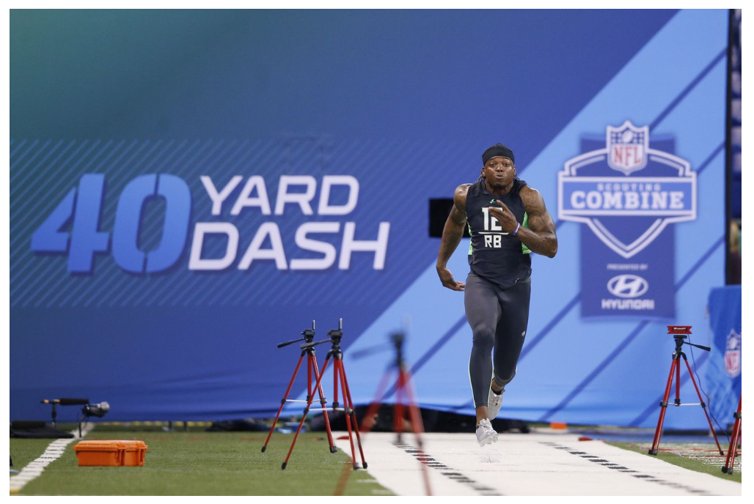

Slide 23
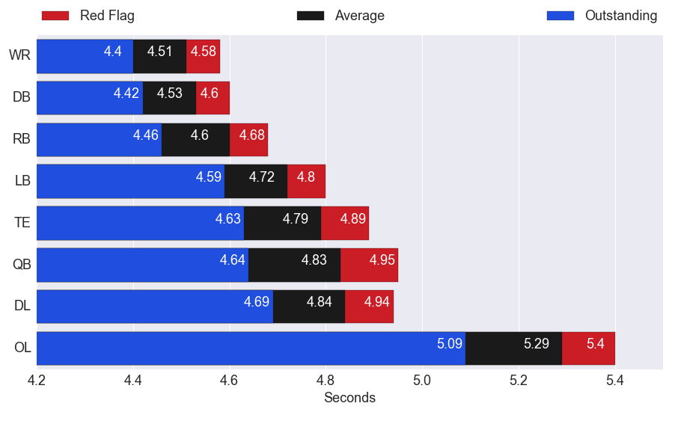

Slide 24
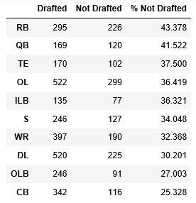

Slide 25
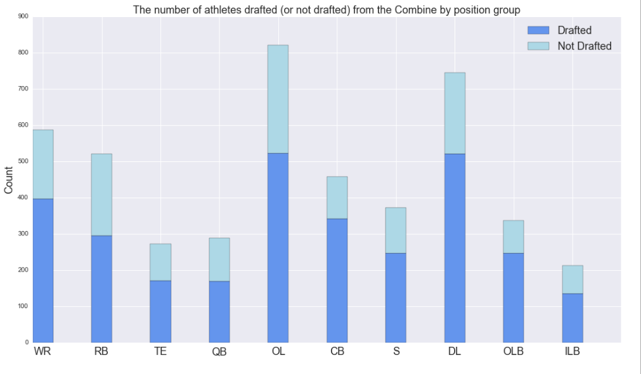

Slide 26
































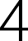





























Slide 27























Slide 28
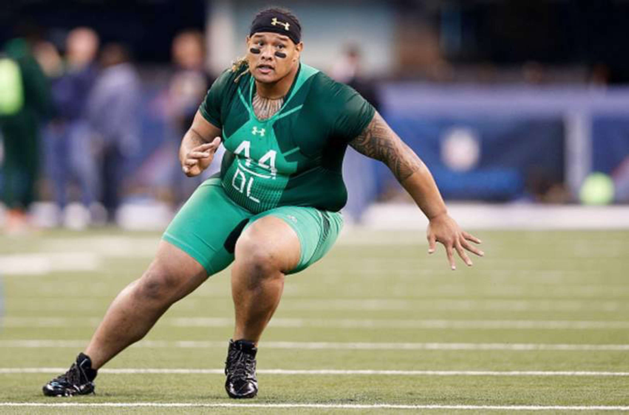

Slide 30
























Slide 31

Predictive Value
Undrafted
Drafted

Slide 32
Predictive Value
Undrafted
Drafted
69%

Slide 33
Predictive Value
Undrafted
Drafted
69%
97%

Slide 34
Identifying Outcomes
Undrafted
Drafted

Slide 35
Identifying Outcomes
Undrafted
Drafted
94%

Slide 36
Identifying Outcomes
Undrafted
Drafted
94%
80%

Slide 37
Conclusion

Slide 38
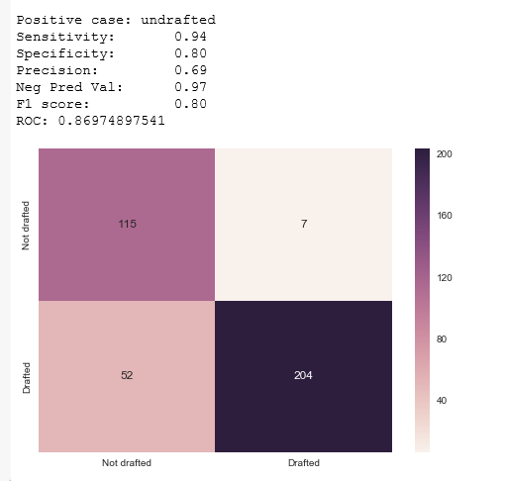

Slide 40
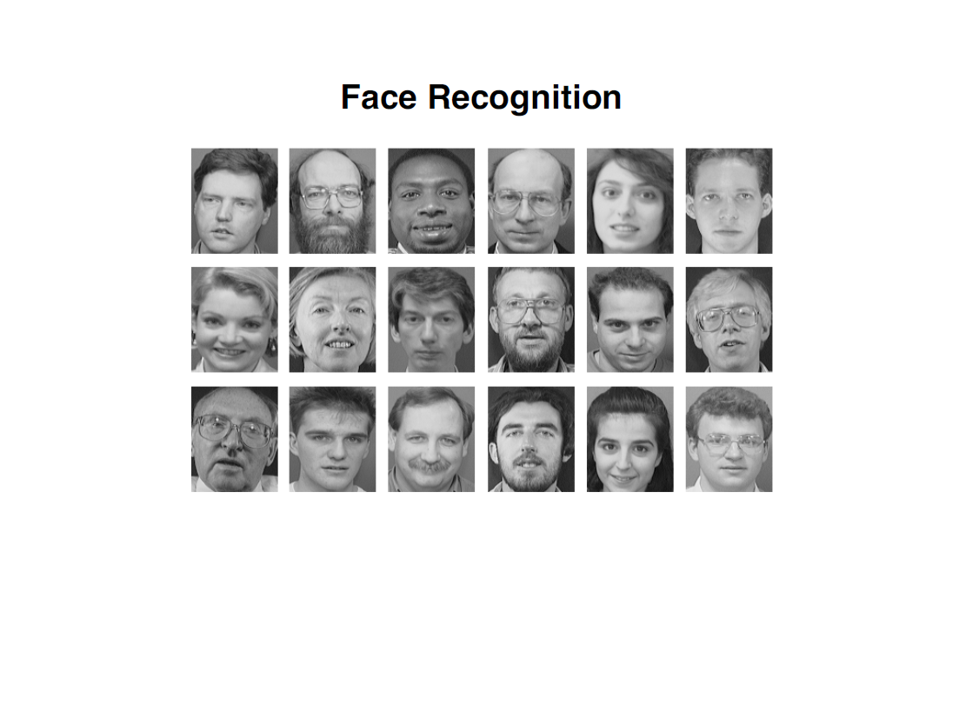

Slide 41
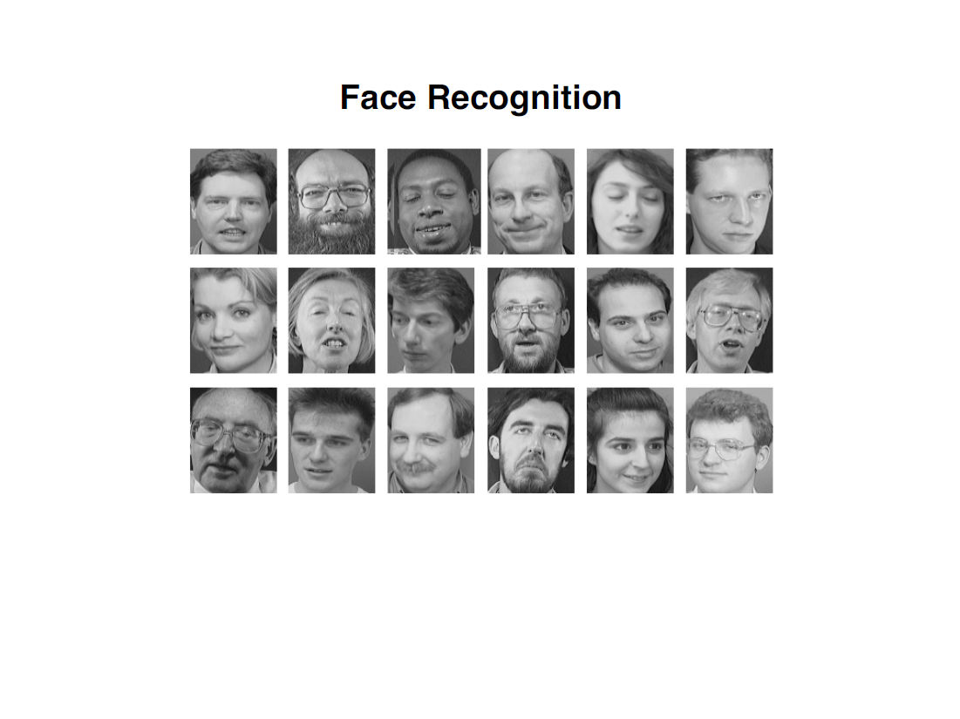

Slide 42
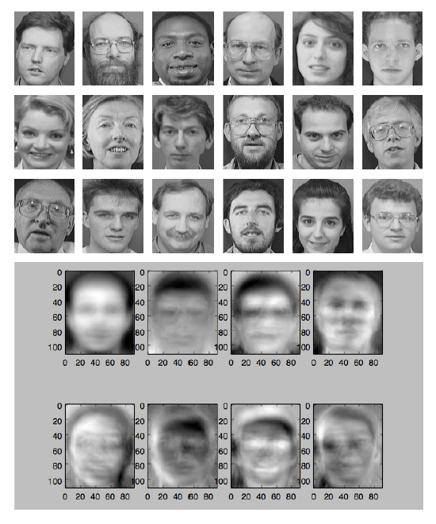

Slide 43
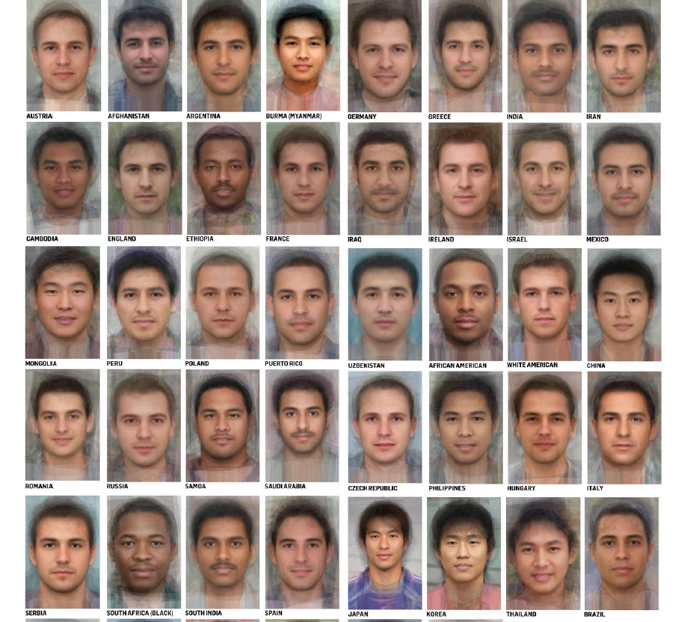

Slide 44
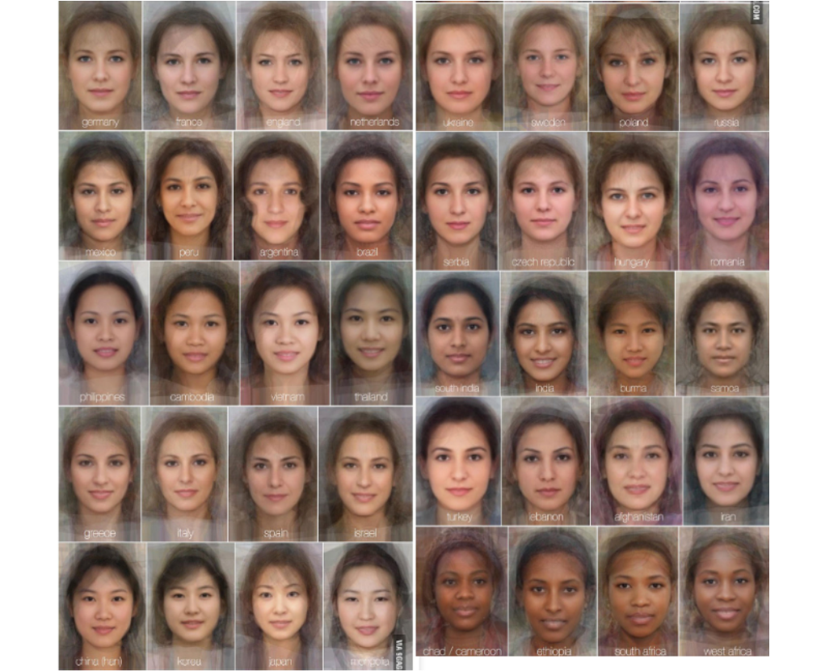

Slide 45
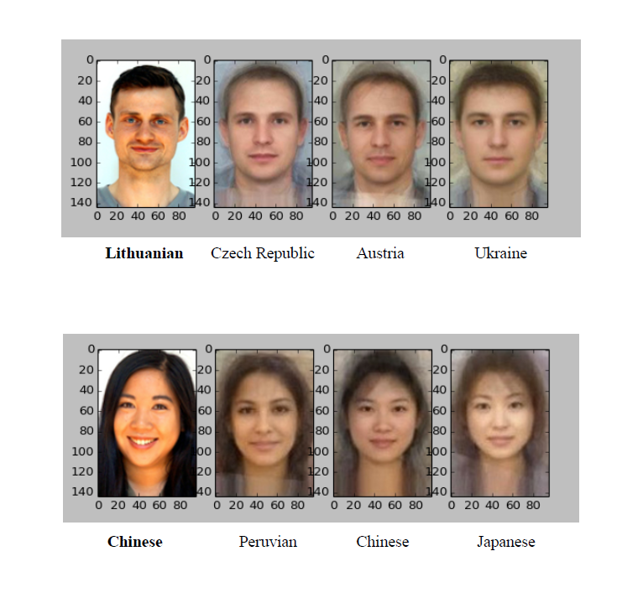

Slide 47
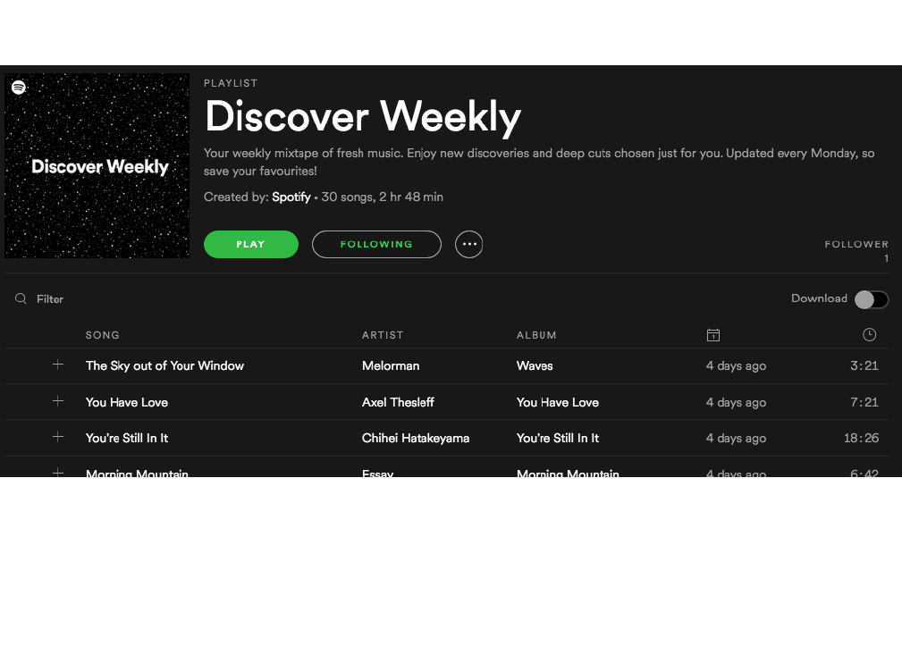

Slide 48
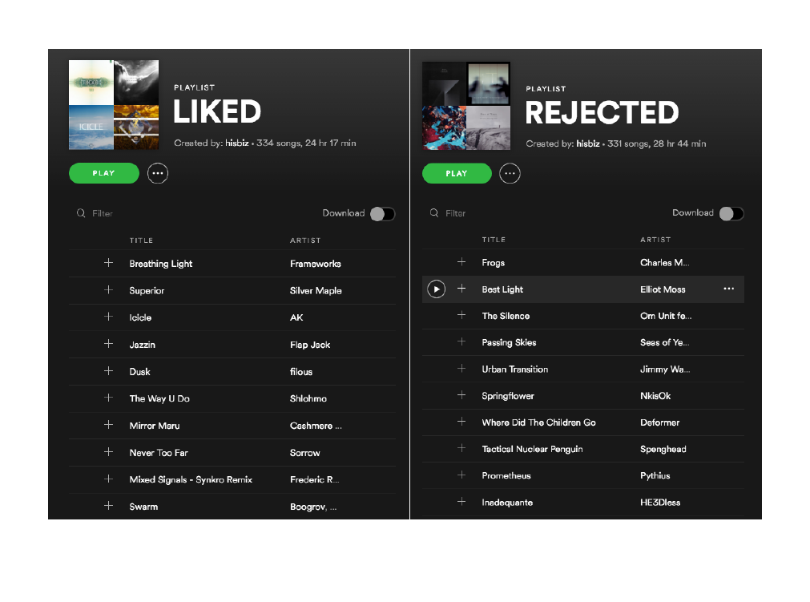

Slide 49


Slide 50
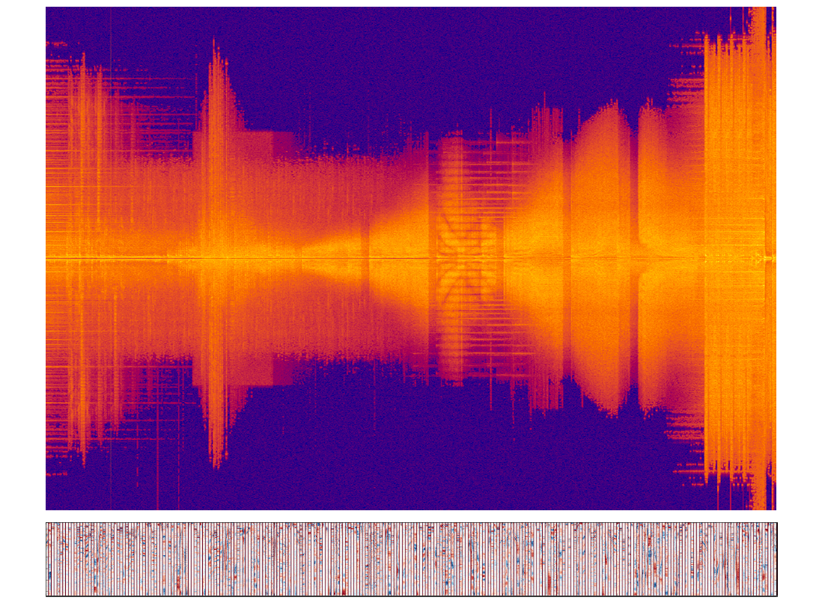

Slide 51
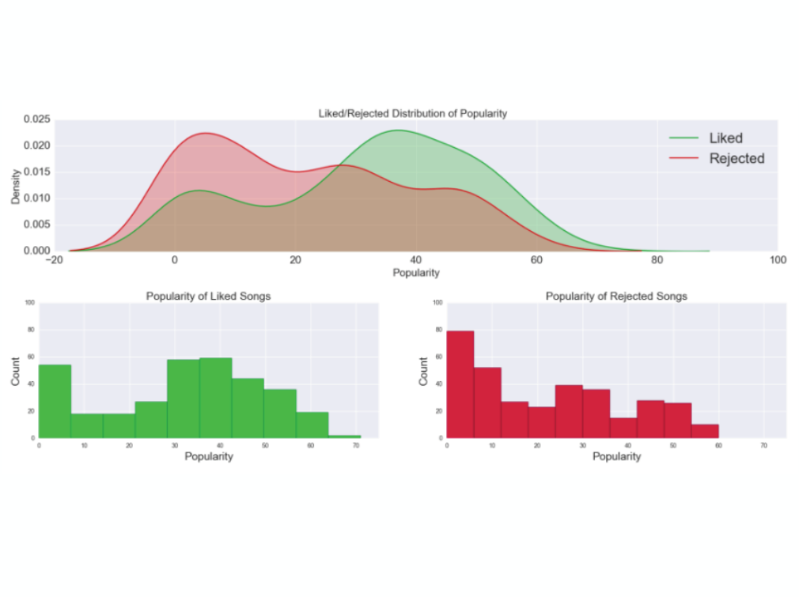

Slide 52
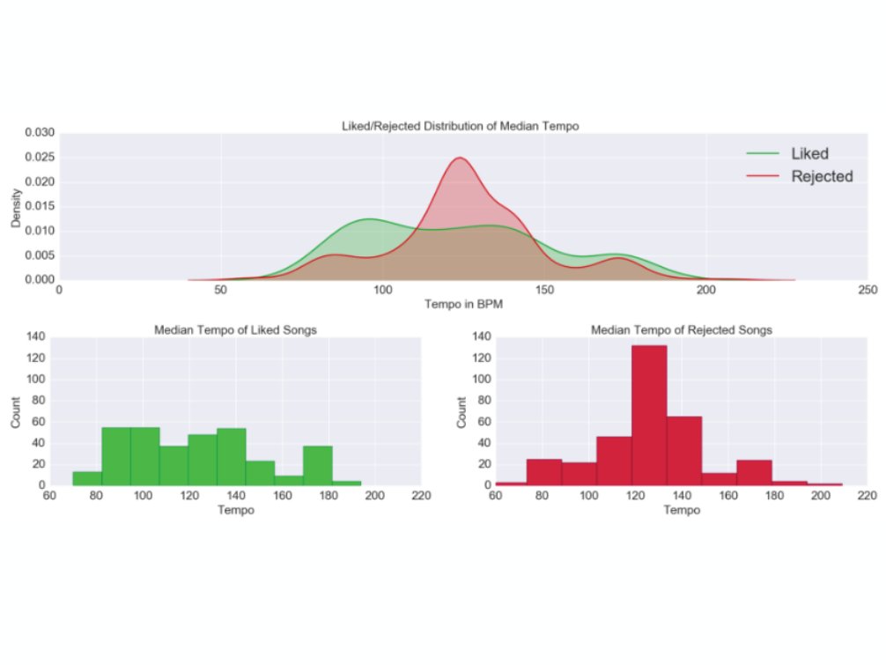

Slide 53
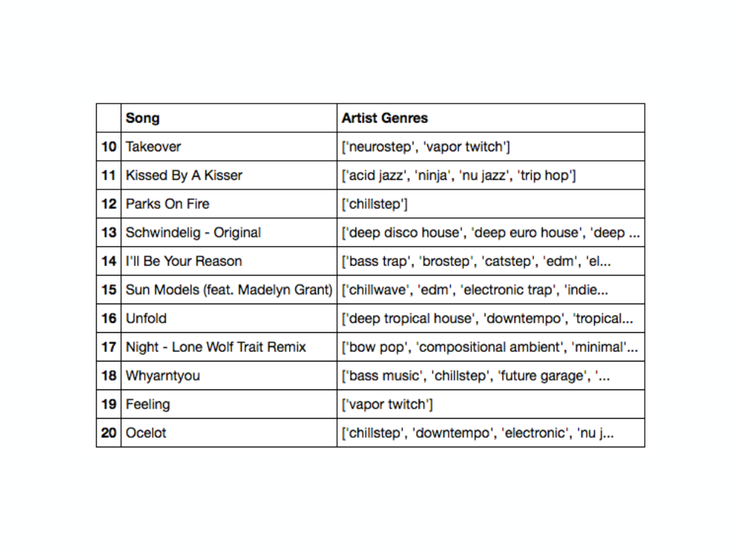

Slide 54
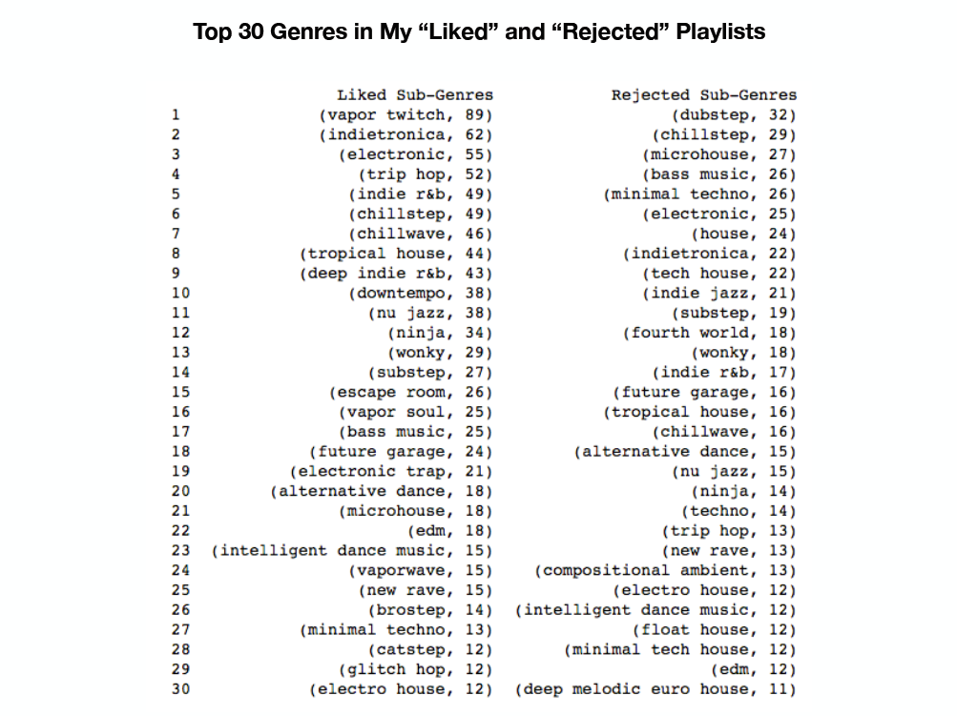

Slide 55
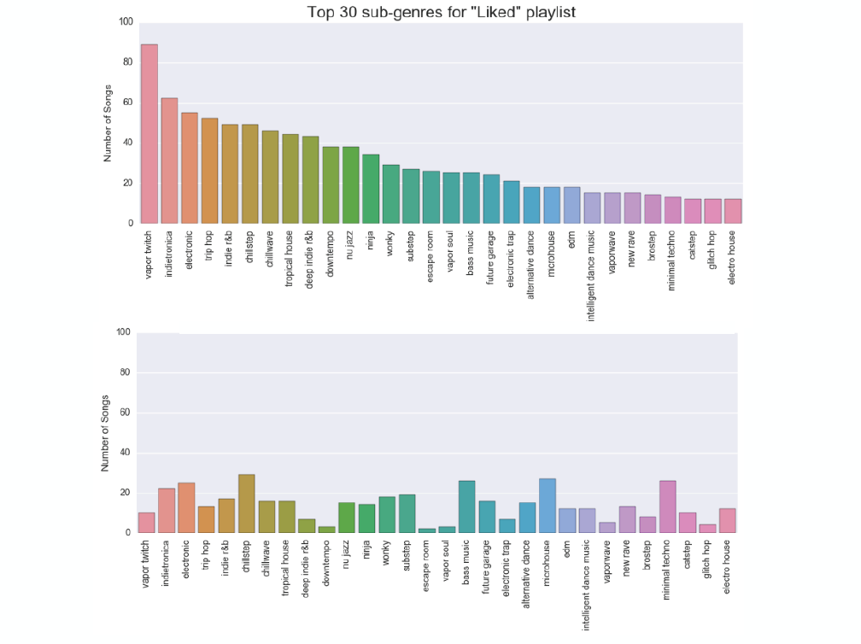

Slide 56














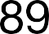
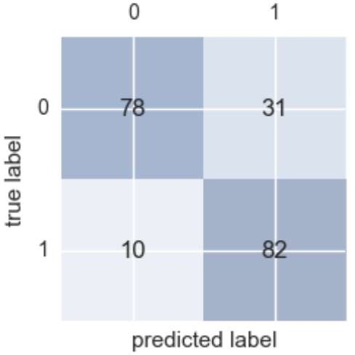

Slide 59
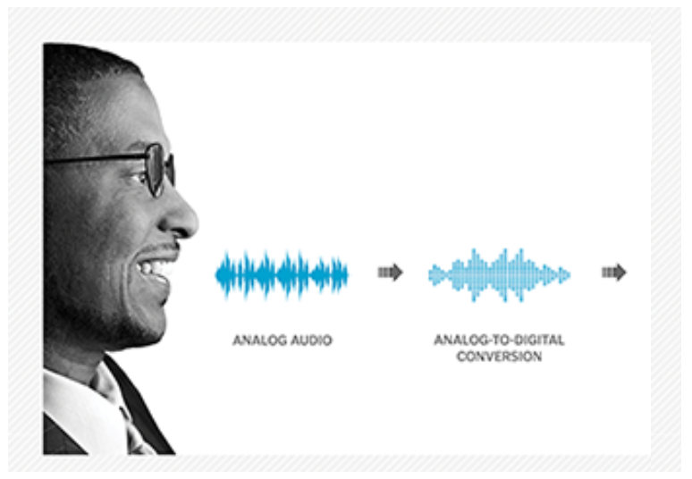
Recognizing Race by Voice

Slide 61

“Apple became the first U.S. company to surpass
$1 trillion in market value.”
- Wall Street Journal, August 2, 2018

Slide 62

Tech companies are amassing wealth and
power, creating a new order in business where the most valuable resource is no longer oil, but
data.
- Wall Street Journal, September 5, 2018

Slide 63
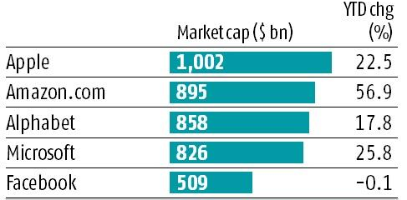
Top 5 Companies in the World

Slide 64
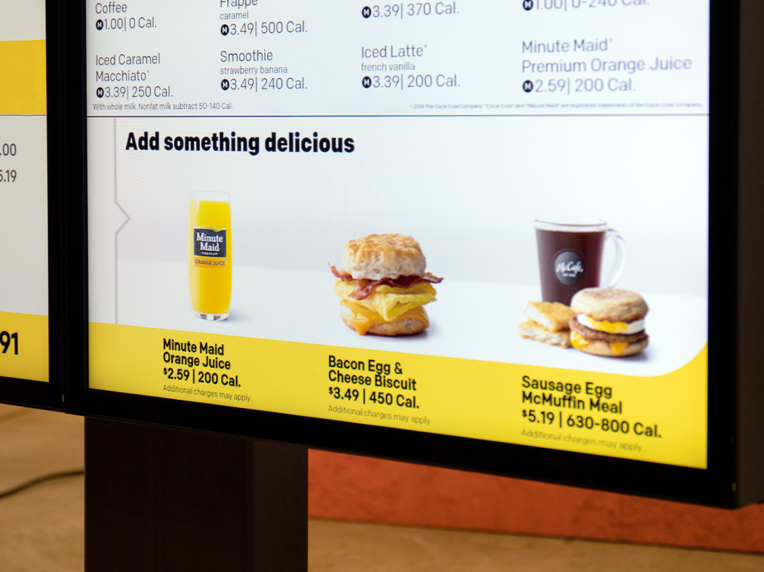
“We’re expanding our ability to increase the role technology and data will play in our future and create more personalized experiences for our customers.”
March 25, 2019
Steve Easterbrook, McDonald’s CEO

Slide 66
Next steps
Make a custom plan for yourself to continue this journey
Improve some of your skills (Stats, Python, ML, Domain, etc.)
Take some additional courses
Try a Kaggle.com competition
Work on a personal project to improve understanding and motivate your learning

Slide 67
Useful Data Science and Machine Learning books for beginners to intermediate:
Book | Author
Data Smart: Using Data Science to Transform Information Into Insight | John W. Foreman
Naked Statistics: Stripping the Dread from the Data | Charles Wheelan
An Introduction to Statistical Learning | Robert Tibshirani and Trevor Hastie
Python Machine Learning | Sebastian Raschka and Vahid Mirjalili
The Hundred-Page Machine Learning Book | Andriy Burkov

